Slide 1


St. MARTIN’S ENGINEERING COLLEGE
(An Autonomous Institute)
Dhulapally, Secunderabad– 500100
NBA & NAAC A+ ACCREDITED
Effective Biometric Gait Recognition using One Shot Learning Algorithm
Mr. Shubhankar Mahajan (18K81A0554)
Ms. B. Prathyusha (18K81A0513)
Ms. Maryjane Namya (18K81A0538)
Ms. Ashwitha (18K81A0520)
Under the Guidance of
Dr. M. Narayanan
M. Tech, Ph. D
Professor and Head,
Department of Computer Science and Engineering

Slide 2
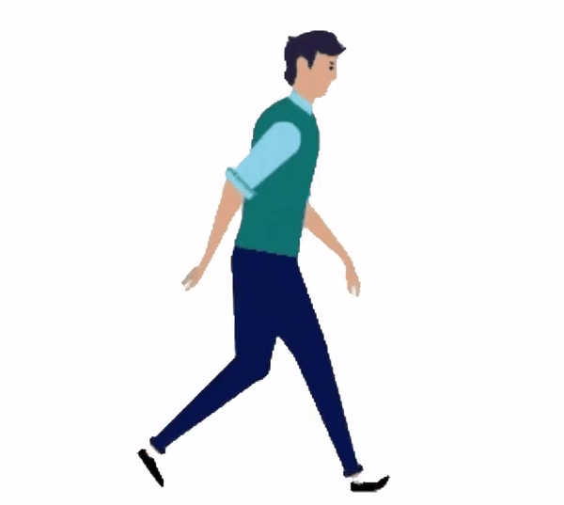
ABSTRACT
Everyone's walking style (gait) is unique, and it has been shown that both humans and computers are very good at recognizing known gait patterns.
This can be used as a biometric form that can be utilized to effectively recognize a person by his/her walking style.

Slide 3

CONTENT
Having to detect faces/acquiring fingerprint to uniquely identify the person in the current situation isn’t ideal and requires cooperation from the people themselves.

Slide 4
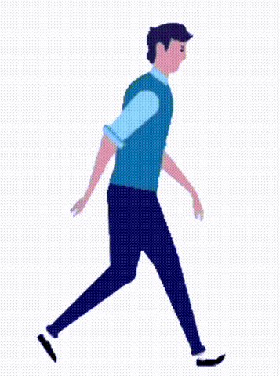
CONTENT
Our project focuses on using techniques such as
Convolutional Neural Network for Gait recognition
Classifiers such as Random Forest, Support Vector Machine (SVM), and Multi Layer Perceptron (MLP) are used for gait recognition with the help of
Local Binary Patterns (LBP)
Histogram of Oriented Gradient (HOG)
Fisher Linear Discriminant Analysis for dimensionality reduction and selecting the most discriminant features for gait recognition.
We also propose on using One Shot Learning Algorithm to improve our results

Slide 5
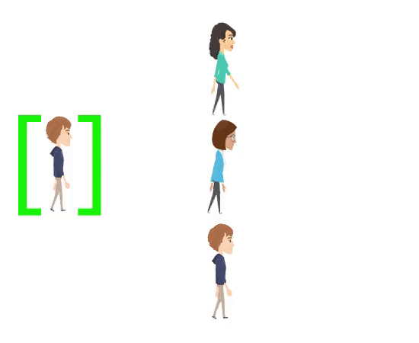
DETAILED DESIGN
We propose on removing the need for a large dataset for Training in other models by using One Shot Learning Algorithm.
The algorithm, as the name suggests, uses only one sample to familiarize itself with how a person’s gait should look and then compares it with the testing image to recognize whose gait it is.
Thus, it requires only one GEI (Gait Energy Image) for recognition.

Slide 6
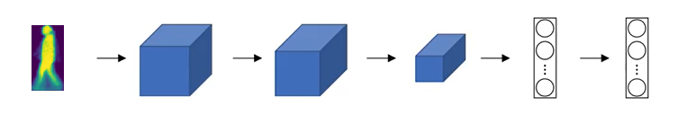
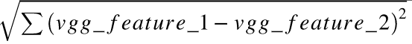
DETAILED DESIGN
(1)
(2)
Siamese Network
- Formula for calculating Distance

Slide 7

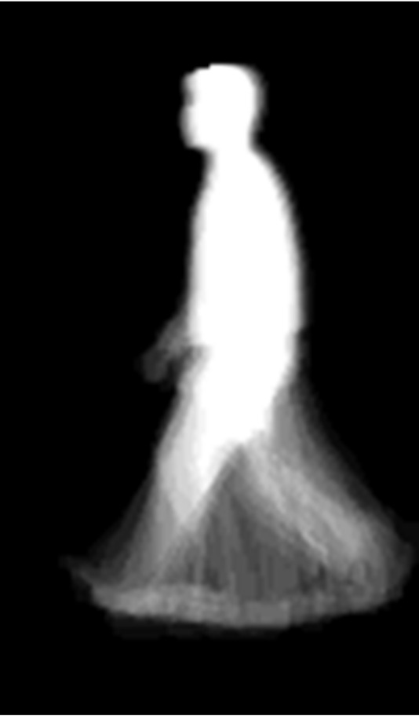

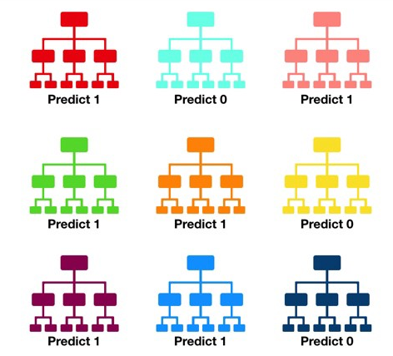
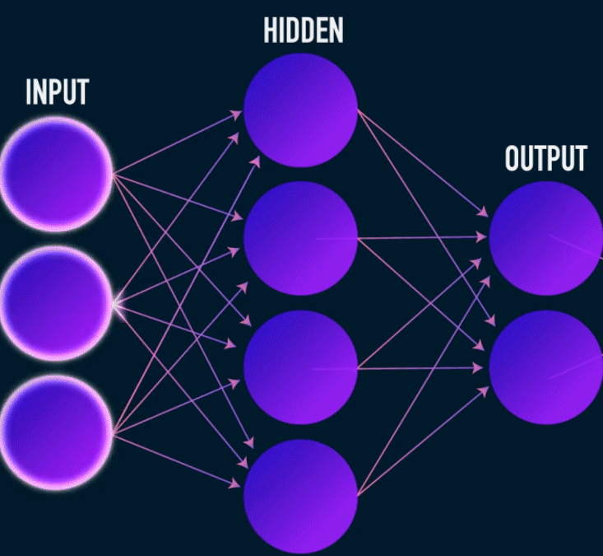
MODULES (SPLIT –UP)
1. Download Preprocessed Datasets from CBSR
2. Generate GEI from Silhouettes
3. Apply
One Shot Learning
4. Comparison
Contributions
Shubhankar Mahajan – Distance from Feature Vectors & MLP
Maryjane Namya – CNN
Prathyusha Bolleypally – GEI & RF
D. Ashwitha – Finding shortest Distance & SVM
+
4.2. Random Forest
4.1. MLP

Slide 8
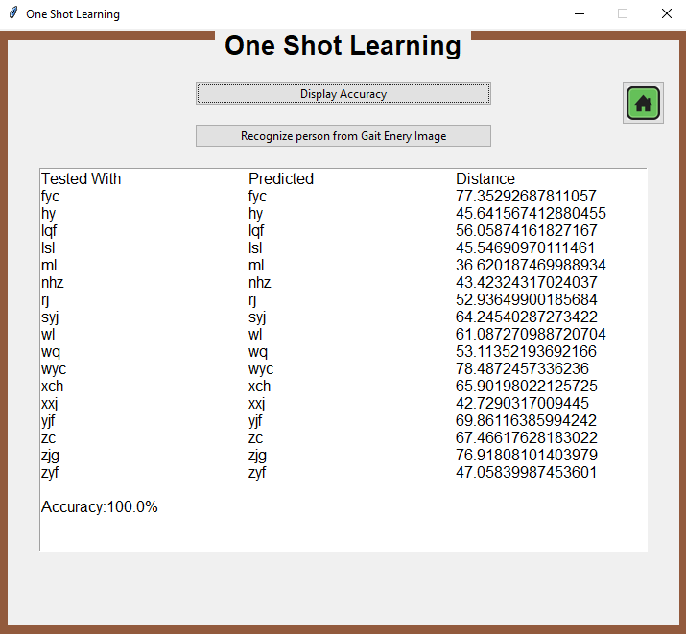
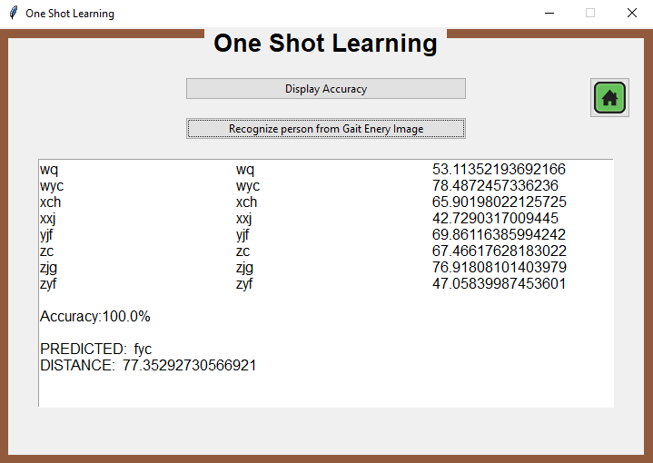
RESULTS OBTAINED
Fig 1: Accuracy
Fig 2: Specific Image Recognition

Slide 9
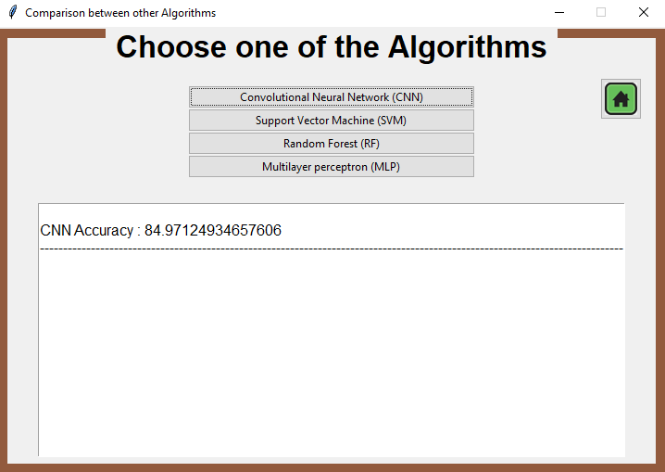
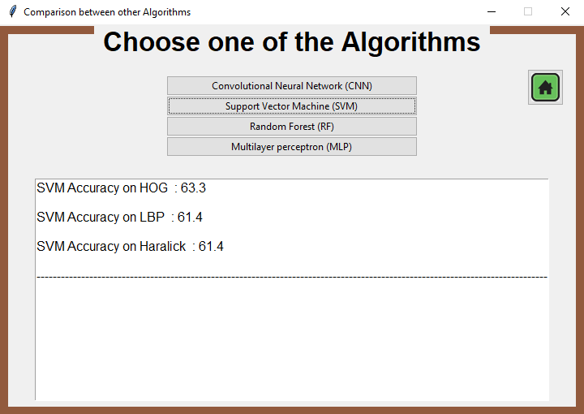
RESULTS OBTAINED
Fig 3: CNN Accuracy
Fig 4: SVM Accuracy

Slide 10
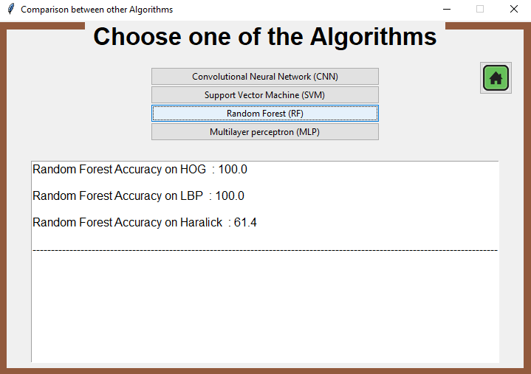
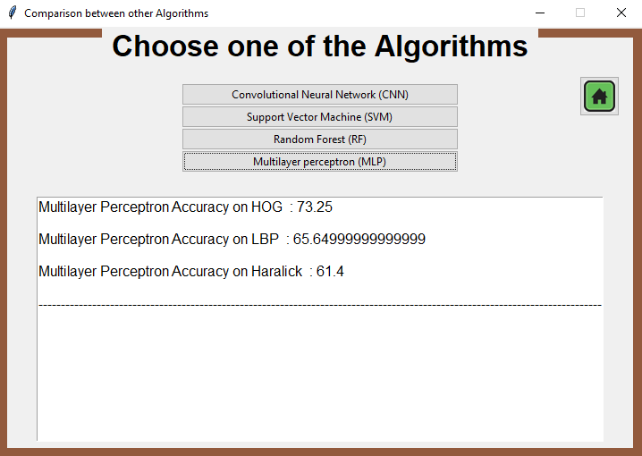
RESULTS OBTAINED
Fig 5: RF Accuracy
Fig 6: MLP Accuracy

Slide 11
REFERENCES
1. An Efficient Gait Recognition Method for Known and Unknown Covariate Conditions.
2. A Survey on Biometric Authentication: Toward Secure and Privacy-Preserving Identification.
3. Comprehensive Study of Biometric Authentication Systems, Challenges and Future Trends.
4. A Survey of Machine Learning Techniques for Behavioral-based Biometric User Authentication.
5. Gait Lateral Network: Learning Discriminative and Compact Representations for Gait Recognition.

Slide 12
REFERENCES
6. GaitSet: Regarding Gait as a Set for Cross-View Gait Recognition.
7. A Model-Based Gait Recognition Method With Body Pose and Human Prior Knowledge.
8. Gait Recognition via Effective Global-Local Feature Representation and Local Temporal Aggregation.
9. Image Deformation Meta-Networks for One-Shot Learning.

Slide 13
QUERIES ??

Slide 14
THANK YOU

